Slide 1
Celonis Exercises
Exercise Sheet 2: Create a custom Dashboard

Slide 2
Exercise 2 Overview
In this task, you take the role of a process analyst. Your goal is to create a Dashboard that visually presents an overview over the topic “Throughput times and bottlenecks”.
For that purpose, we analyze the given (reduced) financial event log of a real-world loan application process¹. If you haven’t already done so for Exercise 1, start by uploading it to Celonis following the Introduction to Celonis slides.
¹Adapted dataset (with the 612 most frequent variants) from: van Dongen, Boudewijn (2012): BPI Challenge 2012. Version 1. 4TU.ResearchData. dataset.
https://doi.org/10.4121/uuid:3926db30-f712-4394-aebc-75976070e91f

Slide 3
Exercise 2
Analysis Dashboard Structure
Title
KPI 1
KPI 2
Header
Visual representation of
the Process
(e.g. Variant or Case Explorer)
Analysis component 1
(e.g. pie chart)
Body
Analysis component 2
(e.g. OLAP table)
Example

Slide 4
Exercise 2
Analysis Dashboard Structure
Title
KPI 1
KPI 2
Header
Visual representation of
the Process
(e.g. Variant or Case Explorer)
Analysis component 1
(e.g. pie chart)
Body
Analysis component 2
(e.g. OLAP table)
Usually, one analysis dashboard refers to a specific use case, e.g. throughput times and bottlenecks in our case. The goal of the dashboard is to concisely present the key components required to understand the use case in one structured visual overview.
An exemplary structure could separate a header, containing the title of the analysis and some relevant Key Performance Indicators (KPIs), from the body of the analysis, comprising more structured information that is relevant to the use case.

Slide 5
Exercise 2
Analysis Dashboard Structure
Title
KPI 1
KPI 2
Header
An expressive title should be chosen that conveys the goal of the dashboard wrt. the use case.
The claim from the title should be backed up by single KPIs describing the relevant properties of the data set.
Visual representation of
the Process
(e.g. Variant or Case Explorer)
Analysis component 1
(e.g. pie chart)
Body
Analysis component 2
(e.g. OLAP table)

Slide 6
Exercise 2
Analysis Dashboard Structure
Title
KPI 1
KPI 2
Header
Visual representation of
the Process
(e.g. Variant or Case Explorer)
Analysis component 1
(e.g. pie chart)
The body of the analysis dashboard should contain a process representation to visualize the relevant process. It can be separated from the header by a horizontal line.
Additionally, further analysis components help the viewer to understand the process and understand the goal of the dashboard in relation to the process.
Body
Analysis component 2
(e.g. OLAP table)

Slide 7
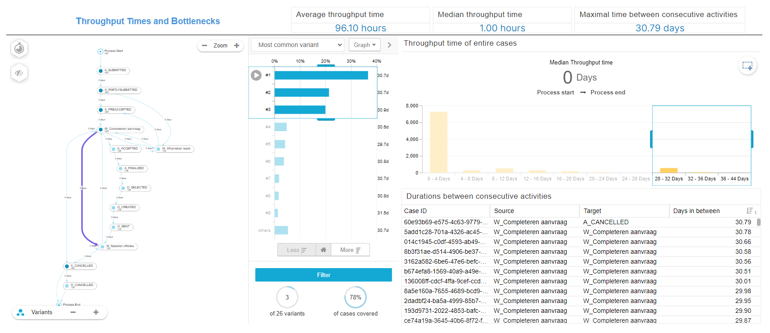
Exercise 2
Final Dashboard in Celonis

Slide 8
Exercise 2
Exercise !
Replicate the above dashboard for the use case “Throughput Times and Bottlenecks”. Use your knowledge over Celonis from the Introduction to Celonis and the additional resources.
In the following, we provide some additional information and tips as a starting point.

Slide 9
Exercise 2
Three single KPIs show the average throughput time per case, median throughput time per case, and the maximal number of hours between two consecutive activities.
💡 For the endmost KPI, you must use SOURCE and TARGET in your PQL formula, which implicitly use an intermediate table of all transitions between two consecutive activities in the event log. SOURCE and TARGET specify the respective outgoing and incoming activities of a directly follows relation.

Slide 10
Exercise 2
💡 This component is called Throughput Time Search. Here, we select all cases with a duration of at least 28 Days in the end (once you finish the dashboard and click on Preview in the top right corner) to show only the three most common variants of this selection in the variant explorer.
As we use selections here, remember to tick the “Component is not filtered with selections” box on the single KPIs to exclude the selection from impacting the computation of the KPIs, which should consider the entire event log.

Slide 11
Exercise 2
Each row of the OLAP table contains a CASE ID from the case table (!), SOURCE and TARGET activities (corresponding together to directly follows relations contained in the case), and the duration between both activities in days (as a decimal number). Sort the table by descending “Days in between” values.
💡 Verify your results: the top entry should correspond to the “Maximal time between consecutive activities” single KPI, which should extend the PQL formula of the “Days in between” column.

Slide 12
Exercise 2
Good Luck with the Exercise and have fun discovering Celonis! 🎉

